Slide 1

Distributor : PT. Sinergi Global Alkesindo
Limus Pratama Regency Jl. Cemara Blok J no 15
Cileungsi –Bogor 16820 , 021 80488754
HP.: 088989726035

Slide 2
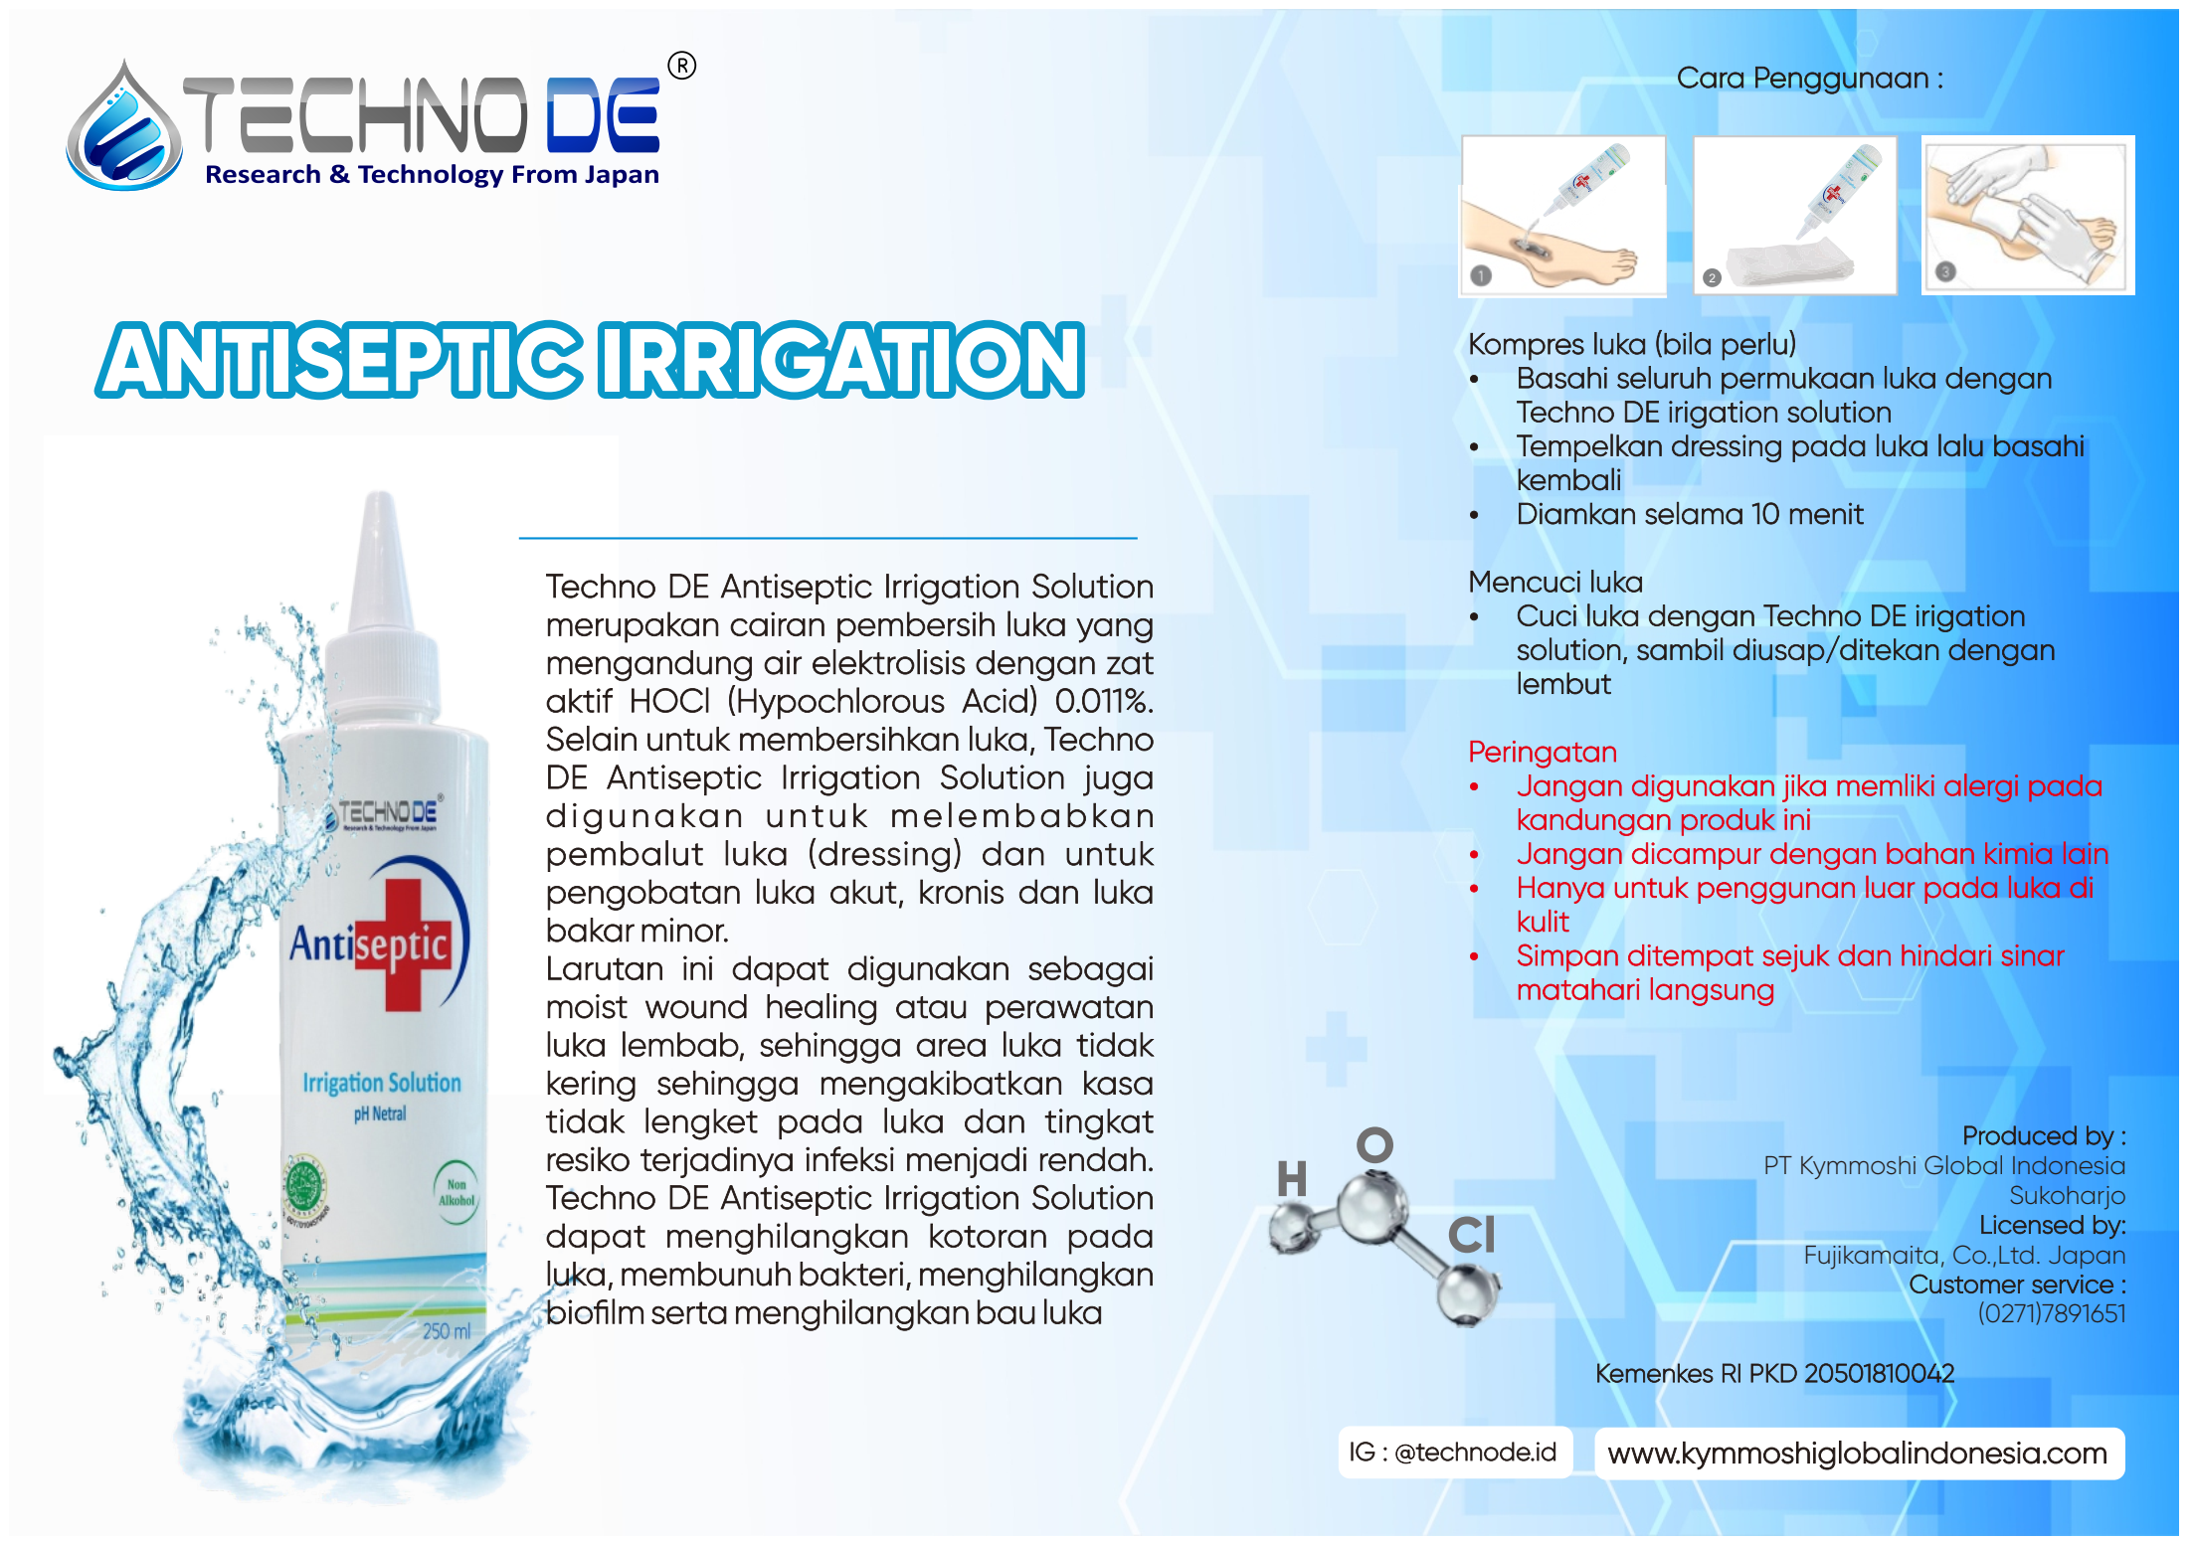


Distributor : PT. Sinergi Global Alkesindo
Limus Pratama Regency Jl. Cemara Blok J no 15
Cileungsi – Bogor 16820 , 021 80488754
HP.: 088989726035

