Slide 1

PT.SINERGI GLOBAL ALKESINDO

Slide 2
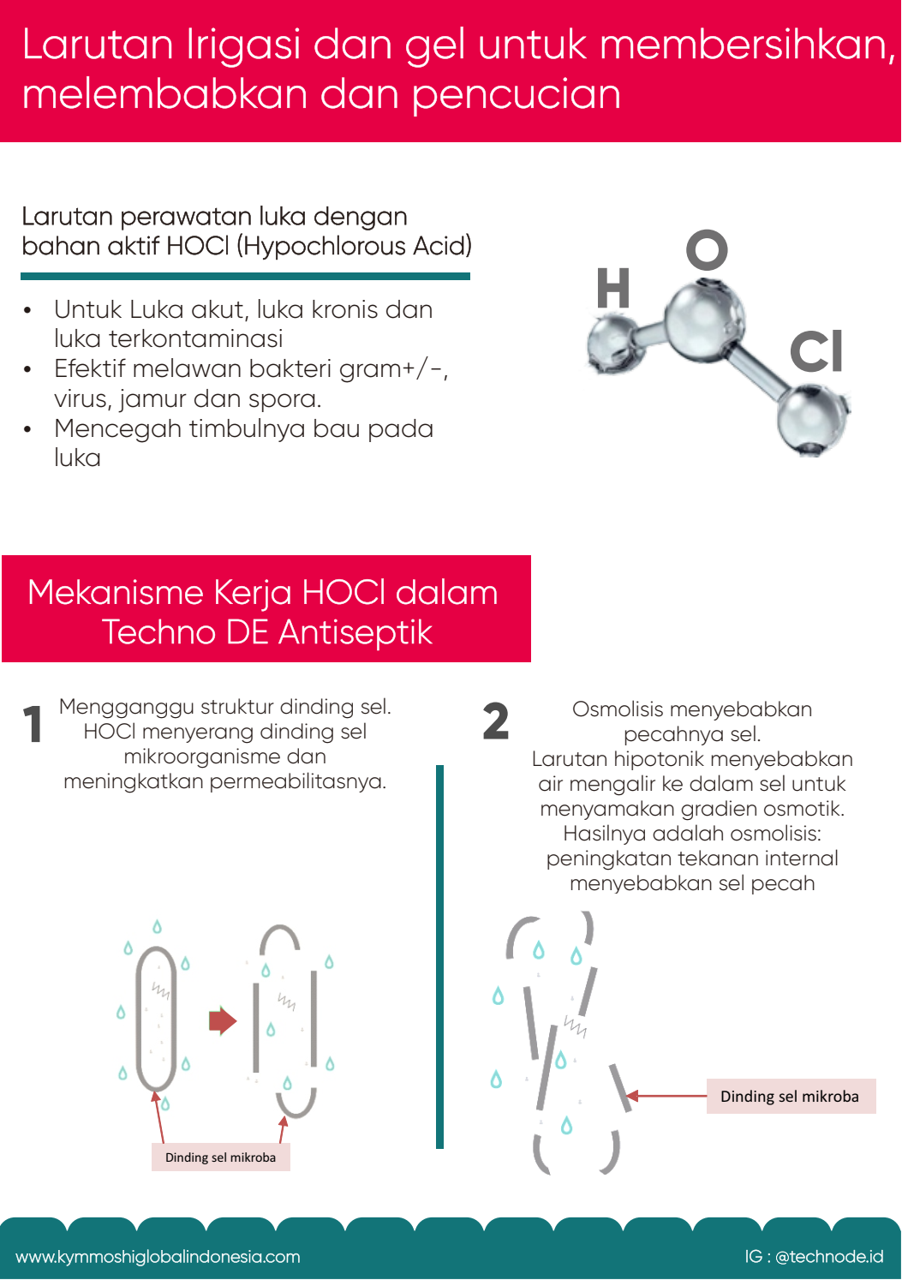
PT.SINERGI GLOBAL ALKESINDO

Slide 3
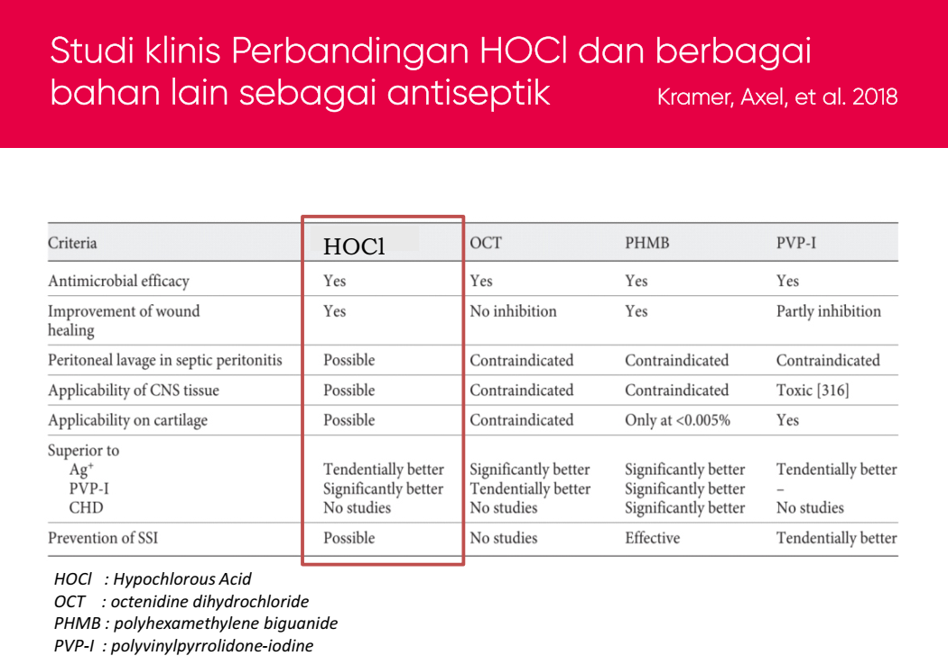
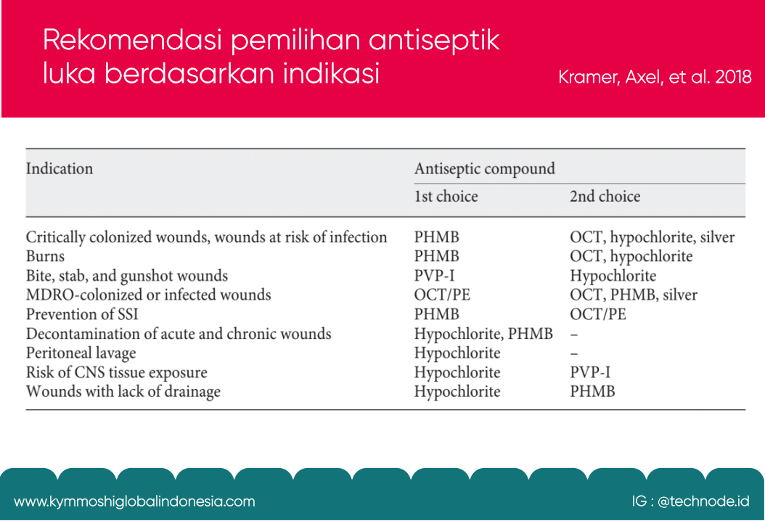
PT.SINERGI GLOBAL ALKESINDO

Slide 4

PT.SINERGI GLOBAL ALKESINDO

Slide 5
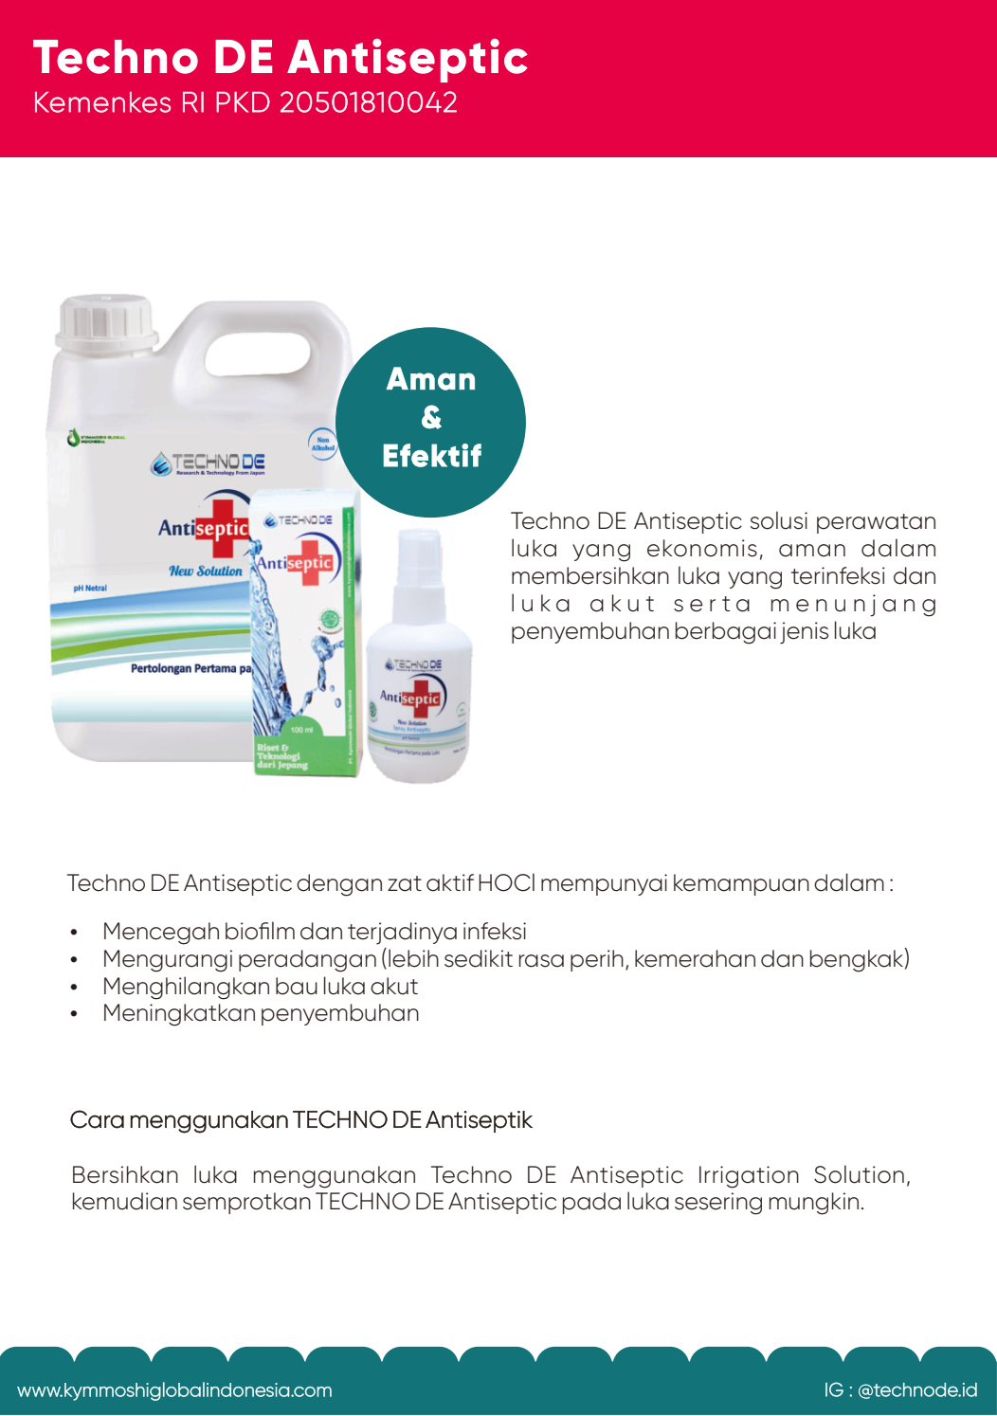
PT.SINERGI GLOBAL ALKESINDO

Slide 6
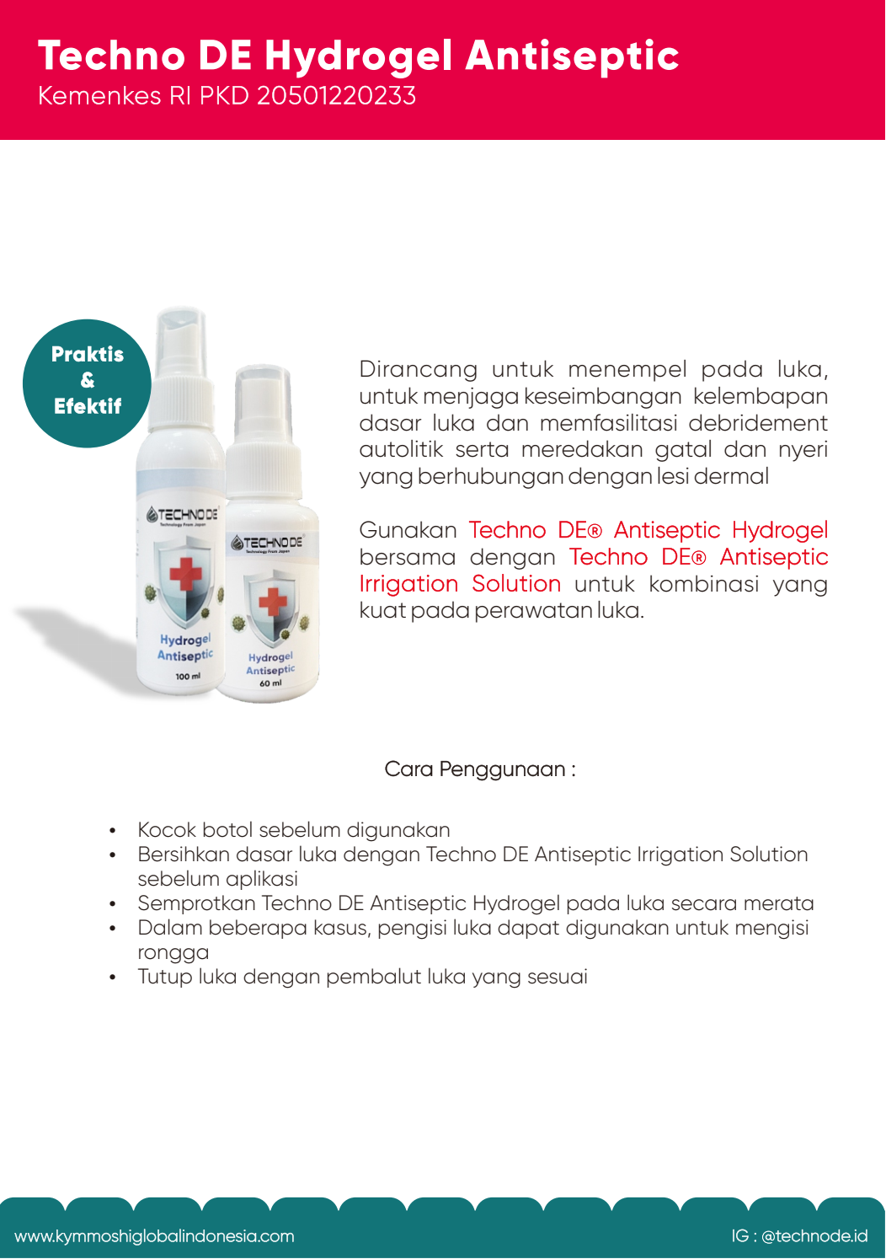
PT.SINERGI GLOBAL ALKESINDO

Slide 7
PT.SINERGI GLOBAL ALKESINDO

Slide 8

PT. SINERGI GLOBAL ALKESINDO
Head Office :
  Limus Pratama Regency; Jl. Cemara Blok J no. 15 Limus Nunggal-Cileungsi Bogor 16820
  Phone: (+62)21-80488754;
  WA : (+62)88989726035;
  Email: office.ptsga@gmail.com
PT.SINERGI GLOBAL ALKESINDO

